Slide 1
CS4499/5599: Data Science and Applied Machine Learning
Class Lecture: March 13th, 2023

Slide 2
Objectives
Last time:
Training Linear Regression Models with Sklearn
Polynomial, Lasso and Ridge regression
Today:
Using R² to evaluate regression models
Introduction to Classification

Slide 3
Classification
In this class, we have focused on regression models, however the area of machine learning that has excited industry is classification
Classification models attempt to learn the characteristics of a target (commonly referred to as class) based off feature data
Then the model can then be used to predict what class a provided sample belongs to
Supervised classification models use known classes, while unsupervised learning models try to define new classes based off of the data

Slide 4
Classification
Our focus for the next month will be on supervised approaches for classification
There are several different techniques that can be used to train this type of model:
Decision Trees
Random Forest
Logistic Regression
Naïve Bayes
k nearest neighbors
Support Vector Machines
And many man more!

Slide 5
Classification
Classification models come in two forms:
Binary Classification
Multi-class Classification
Some models can only handle binary classification while others are better optimized to handle multiple classes
Just like regression models, there is no one-size fits all model for classification
The performance of your model will largely depend on your data, though there are other factors more within our control

Slide 6
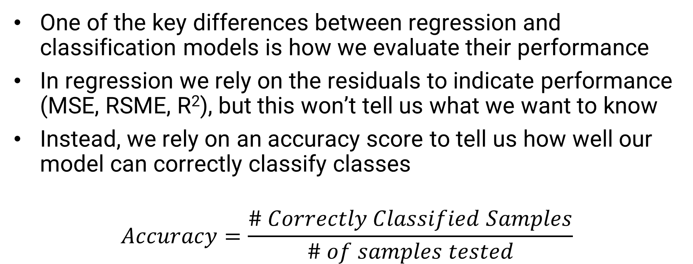
Evaluating Classification Models
One of the key differences between regression and classification models is how we evaluate their performance
In regression we rely on the residuals to indicate performance (MSE, RSME, R²), but this won’t tell us what we want to know
Instead, we rely on an accuracy score to tell us how well our model can correctly classify classes
$$Accuracy=\frac{\# Correctly Classified Samples}{\# of samples tested}$$

Slide 7
Evaluating Classification Models
However, we cannot just rely upon the total accuracy of our model, we need to dig deeper into our model's performance to determine if the model is effective
Consider a binary classification model used to diagnosis a rare deadly illness with an accuracy score of 95%
On the surface this looks great, however, if we don’t carefully examine this model, we could have trouble
Since the illness is rare it is unlikely, my data is balanced (the same number of people with the illness as without it)
Unbalanced data is not uncommon in machine learning

Slide 8
Evaluating Classification Models
Now assume that our training data consisted of 90% healthy people and 10% of sick people
If our model can only correctly classify healthy people, the model is likely not very helpful
In these situations, it can be useful to examine the individual accuracy of each class measure in our model
This can give us a more complete picture of our model’s performance
A handy tool to help with that is a confusion matrix

Slide 9
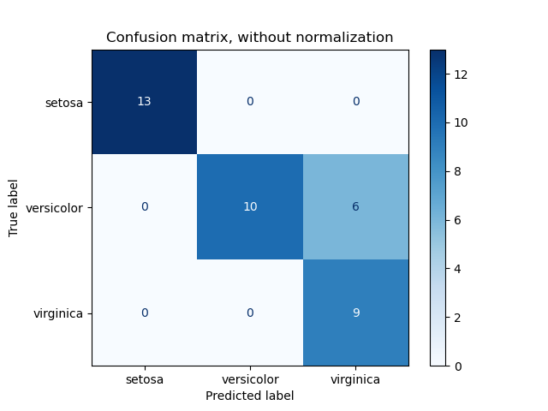
Evaluating Classification Models
The confusion matrix will tell use the number of predictions that were correctly classified by our model
The dimensions of the matrix depending on the number of classes, it will always be (n by n)
Along the diagonal of the matrix, we have the number of true positives for each class
Source: Sklearn Documentation

Slide 10
Evaluating Classification Models
The vertical will test us the number of false positives
Along the horizontal of the matrix, we have the number of false negatives
The power of this is not only do we know how each class performed, but we can also see which classes are giving us the most issues
Source: Sklearn Documentation

Slide 11
Evaluating Classification Models
In classification, accuracy should never be the only validation measurement taken
There are three other common validation scores that should be measured with your model:
Precision
Recall
F1-score
Sklearn has methods for all these scores, that will make our life much easier

Slide 12
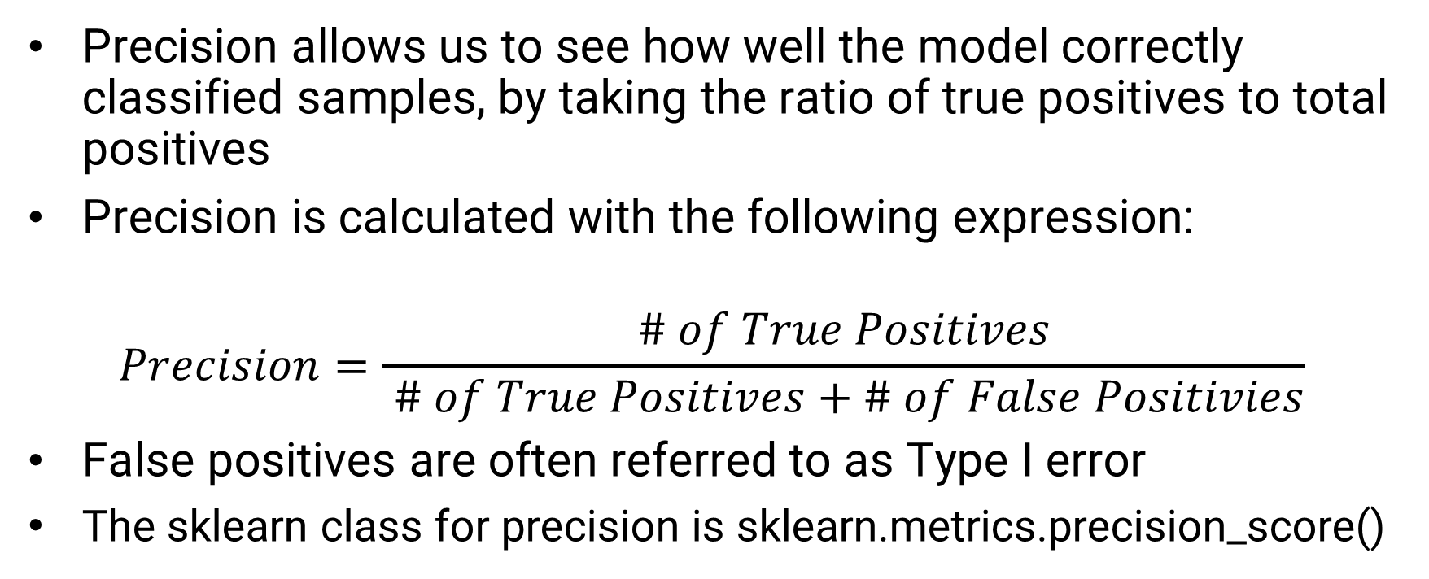
Precision
Precision allows us to see how well the model correctly classified samples, by taking the ratio of true positives to total positives
Precision is calculated with the following expression:
$$Precision=\frac{\# of True Positives}{ \# of True Positives+\# of False Positivies}$$
False positives are often referred to as Type I error
The sklearn class for precision is sklearn.metrics.precision_score()

Slide 13
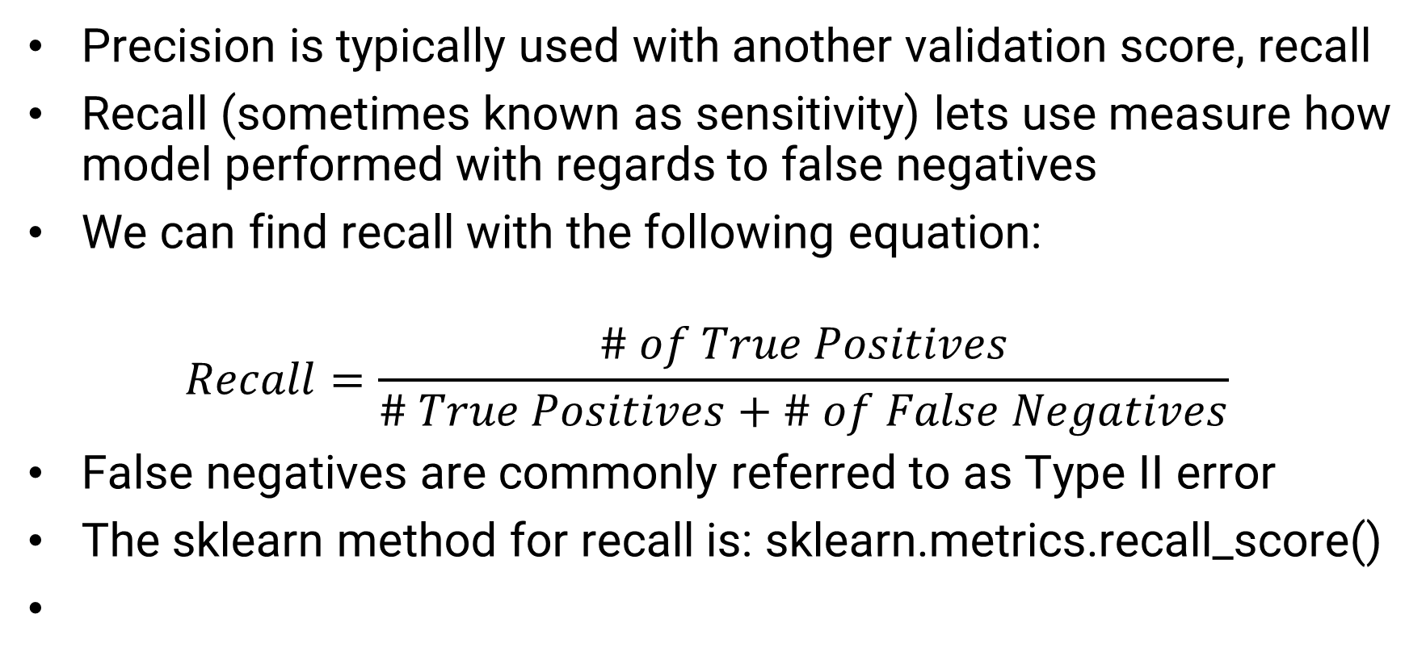
Recall
Precision is typically used with another validation score, recall
Recall (sometimes known as sensitivity) lets use measure how model performed with regards to false negatives
We can find recall with the following equation:
$$Recall=\frac{\# of True Positives}{\# True Positives+\# of False Negatives}$$
False negatives are commonly referred to as Type II error
The sklearn method for recall is: sklearn.metrics.recall_score()

Slide 14
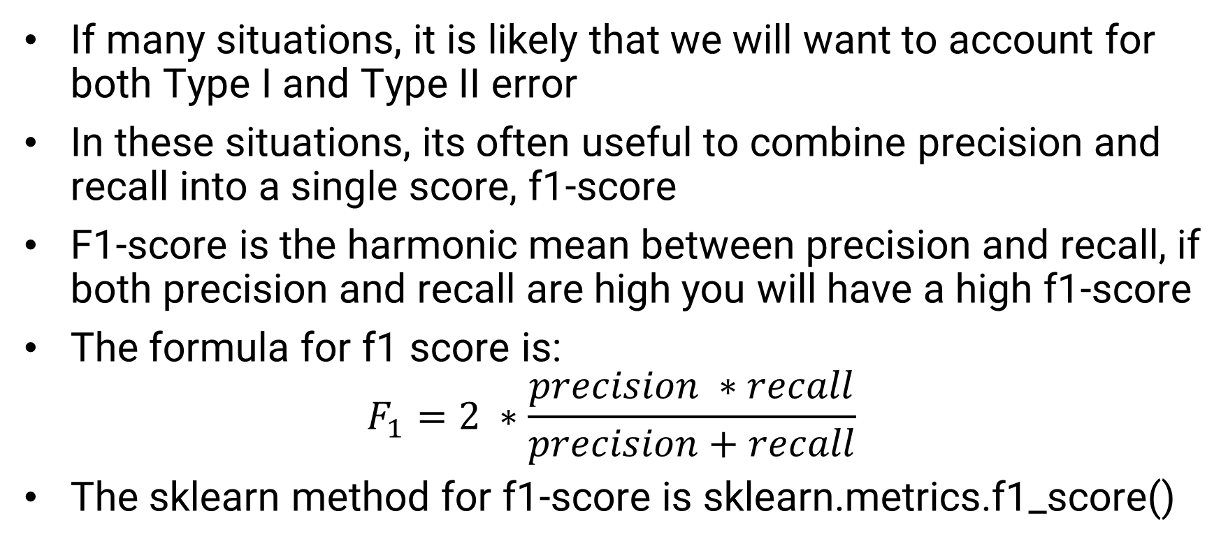
F1-Score
If many situations, it is likely that we will want to account for both Type I and Type II error
In these situations, its often useful to combine precision and recall into a single score, f1-score
F1-score is the harmonic mean between precision and recall, if both precision and recall are high you will have a high f1-score
The formula for f1 score is:
$$F_{1}=2 ∗\frac{precision ∗recall}{precision+recall}$$
The sklearn method for f1-score is sklearn.metrics.f1_score()

Slide 15
Precision/Recall Trade-Off
The threshold for a classification is an important consideration
For example, lowering the threshold will likely reduce precision and increase recall (and vice-versa)
Determining if our machine learning model is effective, depends on the application for the model
If our model is intended to detect shoplifting using images, we likely want a higher recall, while if we are working on a content moderation system, we may focus more on precision
Understanding the objective and goals of the model, can help you determine your model is effective

Slide 16
ROC Curve
A validation measurement that has seen a major increase in popularity is the receiving operating characteristic (ROC) curve
This plot compares the true positive rate (recall) to the false positive rate
This is very useful if we need to compare different classifiers
We can measure the area under the curve and compare this value
Perfect models will have an AUC of 1 while random models will have an AUC equal to 1/n, where n is the number of classes
We won’t make use of this in the class, but know it exist

Slide 17
Hyperparmeters
At this point in machine learning its important we understand the difference between a parameter and a hyperparameter
A hyperparameter is a type of configuration for our machine learning model
The issue is, we cannot see the impact a change in a hyperparmeter will have on model performance until we train and test the model
This can make selecting the optimal hyperparameter very time consuming, especially with more complex models

Slide 18
Hyperparmeters
Hyperparmeters are a major part of most classification models
The regression models we have looked at so far have relatively few hyperparameters
Most of the classification models we will look at will have several different hyperparaters that we can “tune”
There are techniques such as grid search and gradient descent that help us find good values for the hyperparmeters, but for now we will focus on trial and error
As we discuss different types of classification models, we will also take a close look at important hyperparamters

Slide 19
Decision Trees
One of the simplest machine learning models in use today, is also one of the most powerful
Everyday we make choices based on the answers to certain questions
What am I going to eat today?
What am I going to wear today?
What time will I leave my home?
A decision tree make a classification in the same manner, by working through questions until a classification can be made
Let’s work through an example by hand.

Slide 20
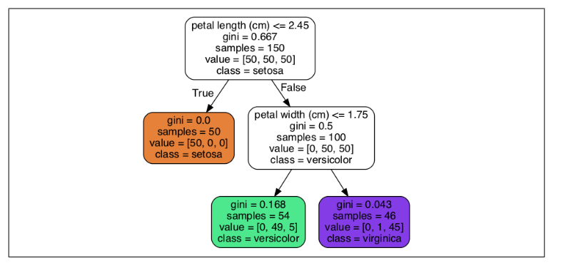
Decision Trees
Sample Decision Tree from the Geron Textbook

Slide 21
Decision Trees
A decision tree model for machine learning will derive the questions based on the data that is provided
The predictions are based simply by the target at the end of the tree path
The nice thing is that decision trees tend not to need very much feature engineering or data scaling
Some decision tree packages even have support for categorical data as well
Another advantage of decision trees is that once trained, it is very quick to get a prediction (traversing a tree is a O(log n) algorithm)

Slide 22
Decision Trees
The questions that we follow in our tree are based on the data we provide
However, this leaves one major questions, how do we determine the order of questions the decision tree should ask? (the order our features split each node)
Afterall with our example we could have posed any of our criteria questions and created a tree that would arrive at similar outcomes
The answer lies in efficiency, we want the tree that will give us the quickest classification possible

Slide 23
Decision Trees
Ideally, we want an algorithm to determine which questions will give use the most “gain” toward our solution
There are two popular metrics we can use to determine this:
Gini Impurity (CART algorithm)
Entropy (ID3 algorithm)
The difference between the two is usually minimal
Sklearn has support for both, but the CART algorithm is most commonly used
This is just one of the hyperparameters we need to choose when training our decision tree

Slide 24

Gini Impurity
Gini Impurity uses the features provided to calculate the probability of a misclassification.
A node’s impurity is a calculated value using the following equation:
Where: p is the ratio of class k instances among the training instance in the ith node
The closer your Gini value is to 0 the “purer” your node is
The node with the lowest Gini value is chosen for the split (i.e. the question that is asked first) The process is repeated to determine the next split

Slide 25
Decision Tree Pruning
Decision tree can become very tall (have lots of nodes)
This can result in models becoming overfit and inflexible
An effective strategy to manage this is “prune” the tree
Here we remove the sections of the tree that provide the least gain (either have low entropy values or high Gini Impurity)
A common approach to prune a tree trained with Sklearn is to make use of the max_depth hyperparameter
If this is not specified, the tree will continue grow until all leaves are pure (assuming you are using Gini Impurity)

Slide 26
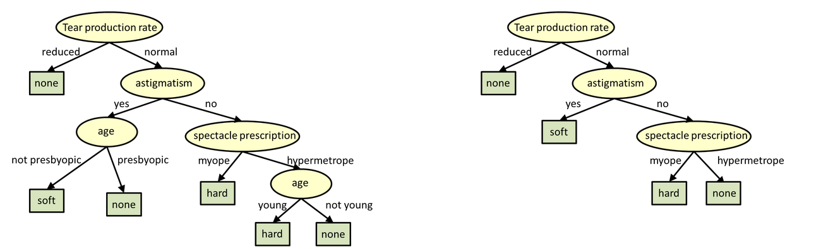
Decision Tree Pruning
Source: Carnegie Melon University

Slide 27
Decision Tree Pros & Cons
Advantages
Decision Trees are among the most accurate non-neural network-based classification models
These are non-parametric models, that requires few assumptions
Less data preparation is needed
Can be easily visualized and explained
This last one is especially important, many machine learning models suffer from the black box effect,
The more involved your application is the more scrutiny your model will be under. White-box models like DTs are tend not to have as much difficulty with this unlike black box models like neural networks

Slide 28
Decision Tree Pros & Cons
Disadvantages
Decision tree models tend to overfit very easily (we will visualize this soon)
Training a decision tree model can be more time consuming than over other non-neural network models
These models can become unstable over time, as changes in the data can have a major impact on the predictions
Decision Tree Regression models have been known to be less effective

Slide 29
Next Time
Go over the concept of classification in machine learning
Assign the midterm project
Go over how to train regression models with DTs
Code up examples using Sklearn
Homework 6 is due before class on 03/15

